Slide 1
Bank Management System By Nabeel Ahmed, Shivam Gehani

Slide 2
Introduction
Banking System
Services
Digital Account

Slide 3
Problem Statement
Manual System
No Backup planning
Error possibility

Slide 4
Project Goals/Objectives
Admin Login
Account Creation
D/W/C Money
Backup Planning

Slide 5
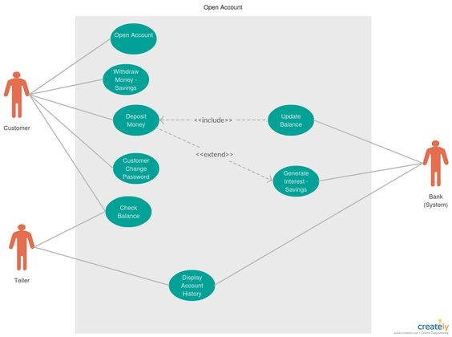
Proposed Methodology

Slide 6
Major Outcomes
Access account anytime anywhere
Assure Security and Privacy
Transaction Record

Slide 7
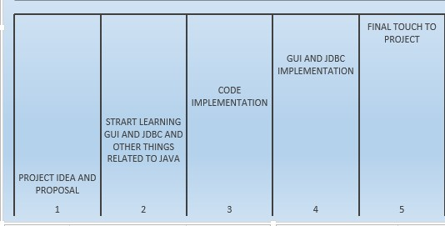
Project Timeline

Slide 8
Conclusion
User Friendly
Basic Financial Transaction
Records Maintaining

Slide 9
Thanks!

